Slide 1

Lending Club Case Study
SHRUTI CHOUDHARY
JEYASHREE M

Slide 2
Problem Statement
When the lending club company receives a loan application, the company has to make a decision for loan approval based on the applicant’s profile. Two types of risks are associated with the bank’s decision:
- If the applicant is not likely to repay the loan, i.e., he/she is likely to default, then approving the loan may lead to a financial loss for the company
- If the applicant is likely to repay the loan, then not approving the loan results in a loss of business to the company
The company wants to understand the driving factors (or driver variables) behind loan default, i.e., the variables which are strong indicators of default. The company can utilize this knowledge for its portfolio and risk assessment.

Slide 3
Business Objective
This company is the largest online loan marketplace, facilitating personal loans, business loans, and financing of medical procedures. Borrowers can easily access lower interest rate loans through a fast online interface.
Like most other lending companies, lending loans to ‘risky’ applicants is the largest source of financial loss (called credit loss). The credit loss is the amount of money lost by the lender when the borrower refuses to pay or runs away with the money owed. In other words, borrowers who default cause the largest amount of loss to the lenders. In this case, the customers labelled as 'charged-off' are the 'defaulters'.
If one is able to identify these risky loan applicants, then such loans can be reduced thereby cutting down the amount of credit loss. Identification of such applicant's using EDA is the aim of this case study.

Slide 4
Data Understanding
Loan Dataset: A dataset of 39717 rows and 111 columns is provided for analysis
https://github.com/shrutich91/LENDING-CLUB-CASE-STUDY/blob/main/loan.csv
Data dictionary: A description and variable definition for all the columns is provided for analysis
https://github.com/shrutich91/LENDING-CLUB-CASE-STUDY/blob/main/data_dictionary.xlsx

Slide 5
Steps involved in Analysis
Importing
Data Cleaning –null values
Data Cleaning – outliers, transformation
Data Summary
Data Integrity Checks
Univariate, Bivariate, Multivariate Analysis
1
2
3
4
5
Importing Libraries and Reading Data
Import all required libraries
Example: pandas, numpy, Math, matplotlib, plotly, seaborn, wordcloud
Null values
- removing columns with all null values
-removing columns with all same values
- removing columns with null values > 60%
- removing columns with distinct values
- removing columns with customer behaviour
- Treating null values if required with mode/mean/median -
Data Types Analysis, Data Formatting, Transformation
Convert the datatype of columns for better analysis
Create derived columns bot better analysis
Treating outliers
- Study skewness, kurtosis
- Identify outliers and treat outliers if required
Data Types Analysis, Data Formatting, Transformation
Convert the datatype of columns for better analysis
Create derived columns bot better analysis
Treating outliers
- Study skewness, kurtosis
- Identify outliers and treat outliers if required
Univariate Analysis
Analyze the distribution of all necessary columns
Bivariate Analysis
Study the target variable against all variables
Identify trends and
observations
Multivariate Analysis
Identify the drivers and create multivariate analysis to reach conclusions

Slide 6
Importing the dataset
- The dataset is imported into pandas dataframe
- Total rows: 39717
- Total columns – 111
- Python Libraries used for analysis:
Pandas for data analysis and transformation
Seaborn, matplotlib, wordcloud, plotly for visualizations

Slide 7
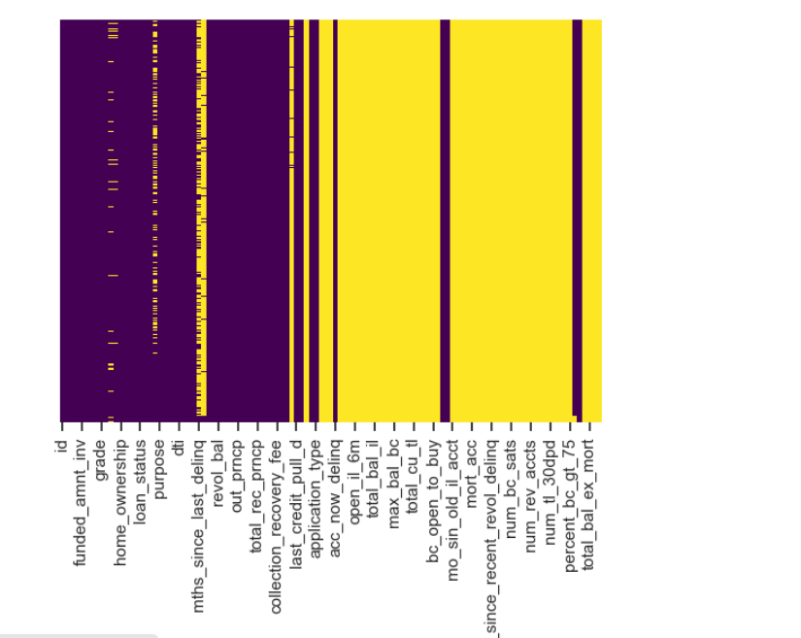
Data Cleaning – Null values
Columns with all null values -54 columns
['mths_since_last_major_derog', 'annual_inc_joint', 'dti_joint', 'verification_status_joint', 'tot_coll_amt', 'tot_cur_bal', 'open_acc_6m', 'open_il_6m', 'open_il_12m', 'open_il_24m', 'mths_since_rcnt_il', 'total_bal_il', 'il_util', 'open_rv_12m', 'open_rv_24m', 'max_bal_bc', 'all_util', 'total_rev_hi_lim', 'inq_fi', 'total_cu_tl', 'inq_last_12m', 'acc_open_past_24mths', 'avg_cur_bal', 'bc_open_to_buy', 'bc_util', 'mo_sin_old_il_acct', 'mo_sin_old_rev_tl_op', 'mo_sin_rcnt_rev_tl_op', 'mo_sin_rcnt_tl', 'mort_acc', 'mths_since_recent_bc', 'mths_since_recent_bc_dlq', 'mths_since_recent_inq', 'mths_since_recent_revol_delinq', 'num_accts_ever_120_pd', 'num_actv_bc_tl', 'num_actv_rev_tl', 'num_bc_sats', 'num_bc_tl', 'num_il_tl', 'num_op_rev_tl', 'num_rev_accts', 'num_rev_tl_bal_gt_0', 'num_sats', 'num_tl_120dpd_2m', 'num_tl_30dpd', 'num_tl_90g_dpd_24m', 'num_tl_op_past_12m', 'pct_tl_nvr_dlq', 'percent_bc_gt_75', 'tot_hi_cred_lim', 'total_bal_ex_mort', 'total_bc_limit', 'total_il_high_credit_limit']
Dropping columns with these conditions
Columns with all same values- 9 columns
['pymnt_plan', 'initial_list_status', 'collections_12_mths_ex_med', 'policy_code', 'application_type', 'acc_now_delinq', 'chargeoff_within_12_mths', 'delinq_amnt', 'tax_liens']
Columns with all distinct values -3 columns
['id', 'member_id', 'url']
Columns with > 60% null values -3 columns
Heatmap with yellow showing null values
['mths_since_last_delinq', 'mths_since_last_record', 'next_pymnt_d']

Slide 8
Cleaning Data – based on data understanding
Customer behaviour variables, After studying the data dictionary, further dropping customer behavior variables as it will not provide insights on defaulters
["delinq_2yrs","earliest_cr_line","inq_last_6mths","open_acc","pub_rec","revol_bal","total_acc","out_prncp","out_prncp_inv","total_pymnt","total_pymnt_inv","total_rec_prncp","total_rec_int","total_rec_late_fee","collection_recovery_fee","last_pymnt_d","last_pymnt_amnt","last_credit_pull_d"]
After analyzing description and zip code, since the number of distinct values are very high, it is better to drop these
[“desc",“zip_code“]

Slide 9
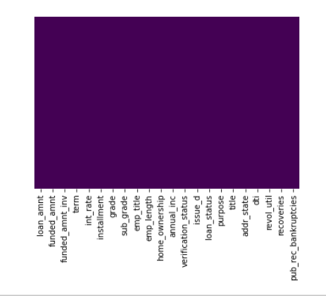
Treating null values
Column | Null value treatment
pub_rec_bankruptcies | Mode
emp_title | None
emp_length | 0 (As numerical analysis is easier for this)
Heatmap after treating null values

Slide 10
Date Manipulation Before & After
BEFORE manipulation OF null VALUES
After manipulation Of null values

Slide 12
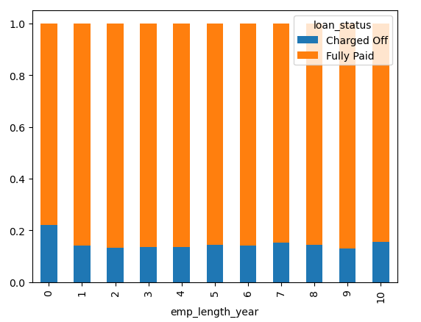
Bi-Variate Analysis
Loan Status(count) Vs Employment Length:
1. Observation - Employment length is not conclusive for any trend
2. Observation - If employment length in NA(plotted as 0) in graph, has higher chance of charged off as compared to others

Slide 13
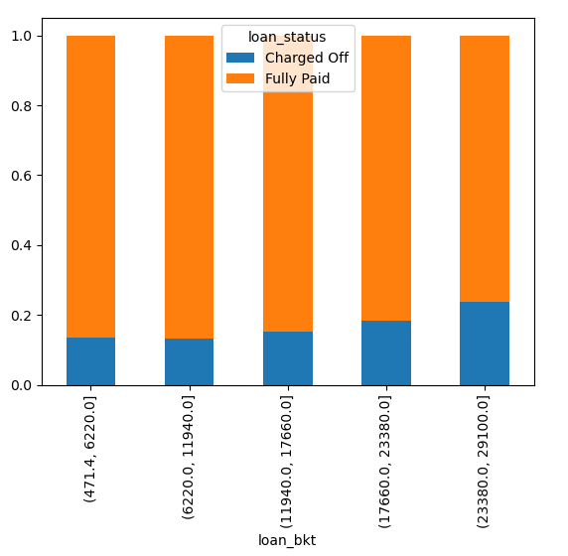
Bi-Variate Analysis
Loan Status(count) Vs Loan Amount:
1. Insight: Loan bucket 23K-30k have highest percentage of chargeoff
2. Trend- As loan amount increases, % charged off increases
Because of correlation, loan amount , funded amount, funded_amnt_inv, installment will follow similar trend

Slide 14
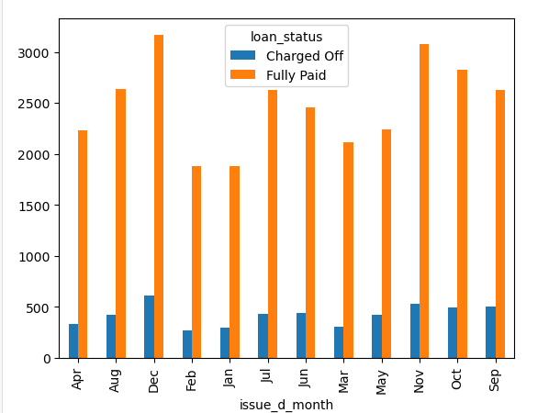
Bi-Variate Analysis
Loan Status(count) Vs Issue Month:
Trends- Across all months dec have got max charged off
Across all years and dec 2011 have for max charged off

Slide 15
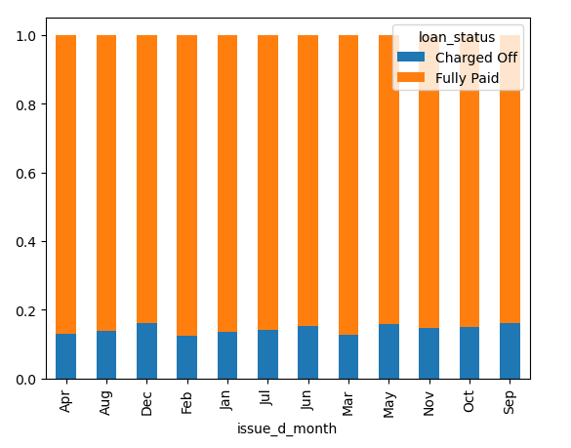
Bi-Variate Analysis
Loan Status(count) Vs Issue Month:
Percentage wise comparison , Dec and sep has more charged off nearly 16.1% charged off against total

Slide 16
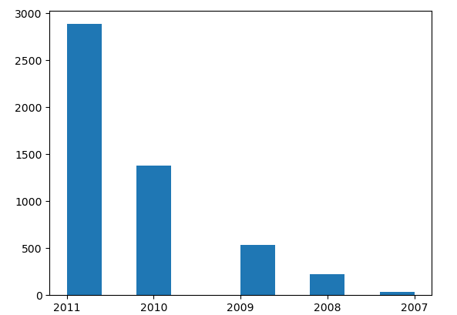
Bi-Variate Analysis
Charged off (loan status) Vs Issue year:
Year by Year if we compare how much charged off count were increasing , 2011 have got 2385 count
Year | Count
2011 | 2385
2010 | 1381
2009 | 538
2008 | 221
2007 | 36

Slide 17
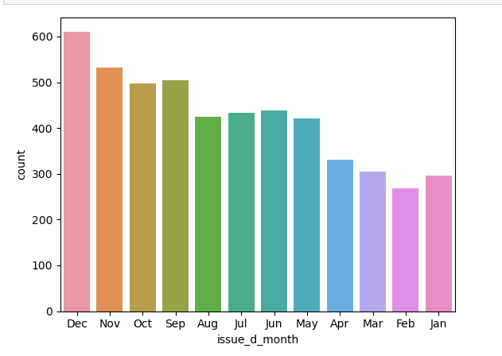
Bi-Variate Analysis
Charged off (loan status) Vs Issue Month:
Countwise among charged off dec 2011 have got max charged off
Month | Count
Dec | 611
Nov | 533
Sep | 504
Oct | 497
Jun | 439
Jul | 433
Aug | 424
May | 421
Apr | 331
Mar | 304
Jan | 296
Feb | 268

Slide 18
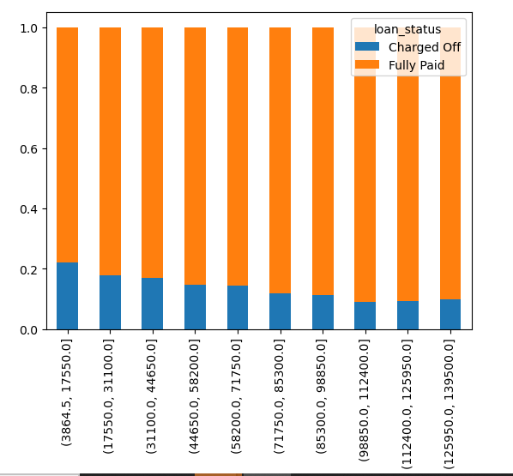
Bi-Variate Analysis
Loan status Vs Income Bucket:
Trends- As income increases increases, %of charged off decreases
Observation - Income <60k has a higher chance of charged off

Slide 19
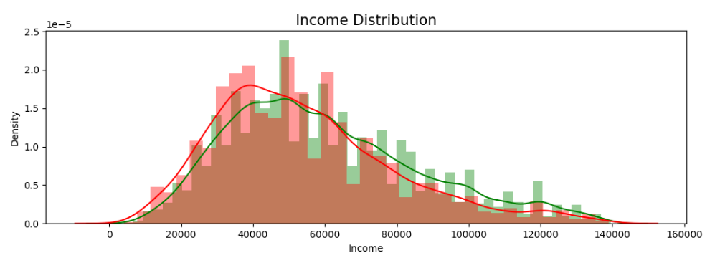
Bi-Variate Analysis
Annual Income vs Loan status :
Observation : Till 60000 income , charged off is more occurring, after 60000 fullpaid is more occurring

Slide 20
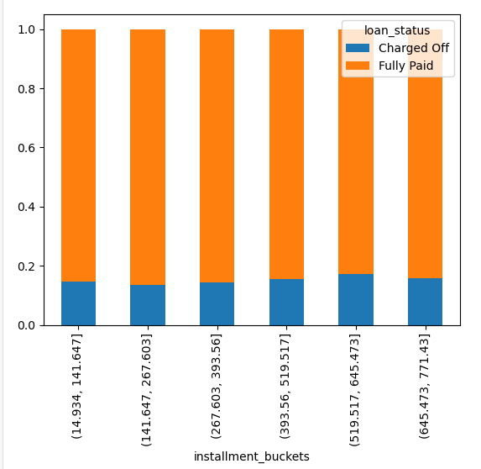
Bi-Variate Analysis
Loan status Vs Installment
It is not conclusive
As installment increases there is no obvious evidence of charged off increase

Slide 21
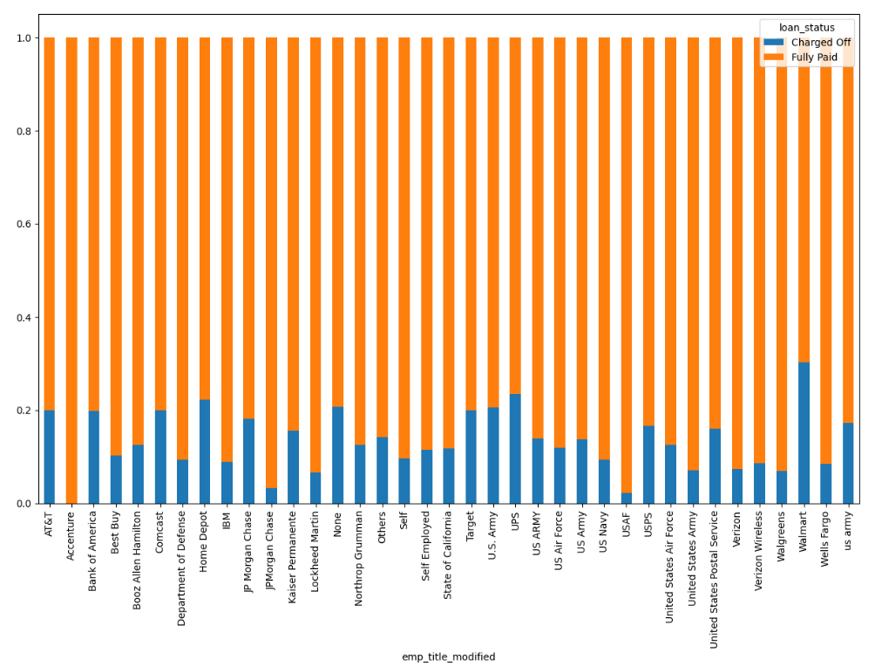
Bi-Variate Analysis
Loan status Vs Title
Insights- title Accenture has no charged off, while Wallmart has highest Charged off
if employee title is null, higher chance of charged off

Slide 22
Bi-Variate Analysis
Loan status Vs Home ownership
(open …needs discussion)…see the charged off and decide

Slide 23
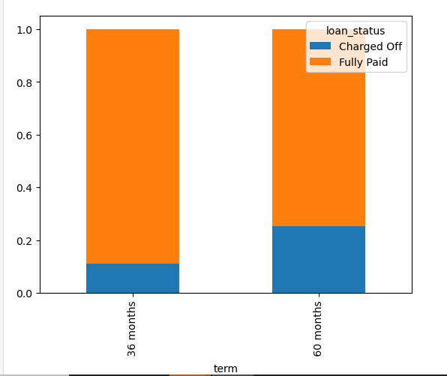
Bi-Variate Analysis
Loan status Vs Term
Insights : chance of charged off is double when term is 60

Slide 24
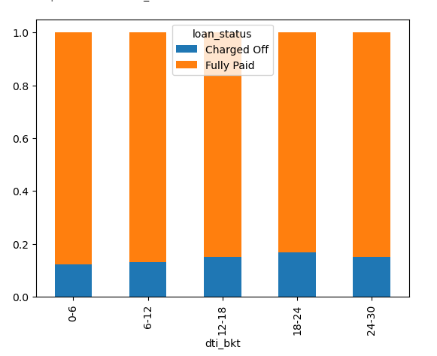
Bi-Variate Analysis
Loan status Vs Dti
Insights : dti is not showing a trend, 18-24% has comparatively higher chance of charged off (see insights of charged off )

Slide 25
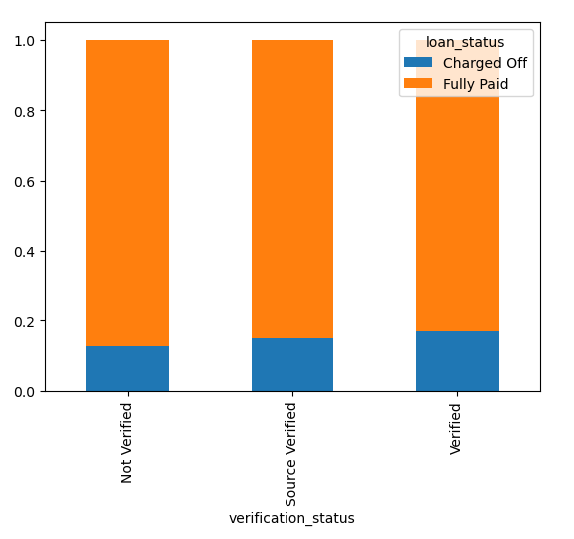
Bi-Variate Analysis
Loan status Vs Verification status
Not conclusive

Slide 26
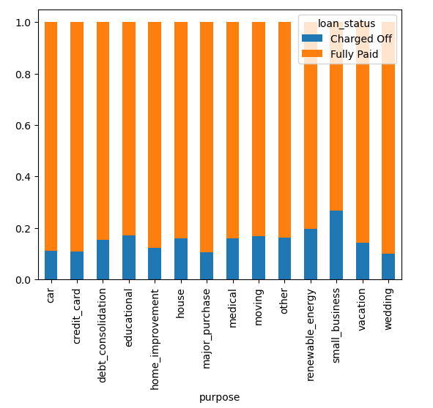
Bi-Variate Analysis
Loan status Vs Purpose
Insights: If purpose=Small business, it has highest(27%) chance of charged of

Slide 27
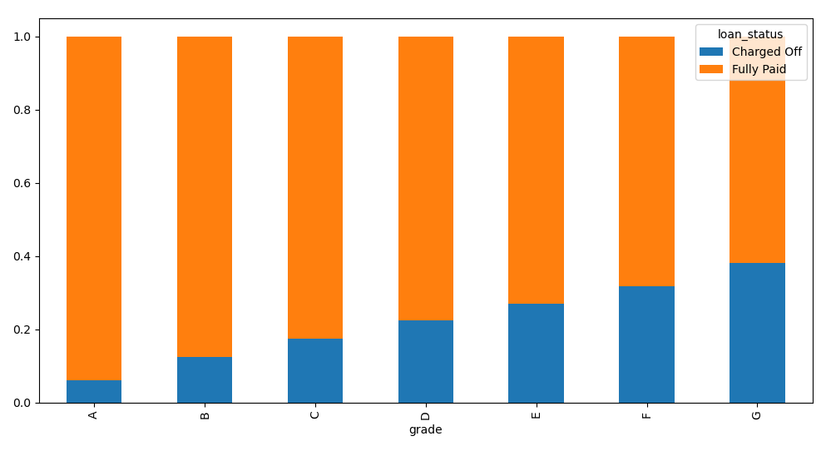
Bi-Variate Analysis
Loan status Vs Grade
Insights: As grade increases(A to B to C), % charged off increases

Slide 28
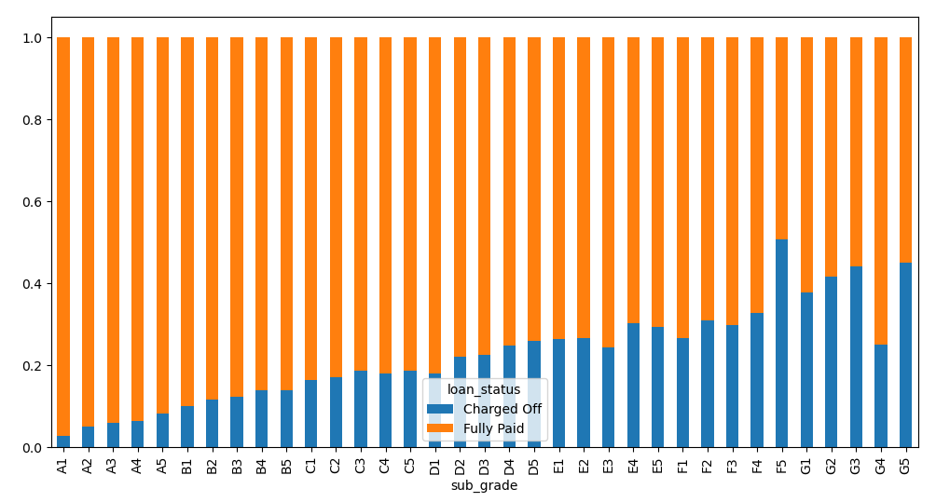
Bi-Variate Analysis
Loan status Vs Subgrade
Insights: As subgrade increases, % charged off increases.
Also For F5 grade more charged off is observed

Slide 29
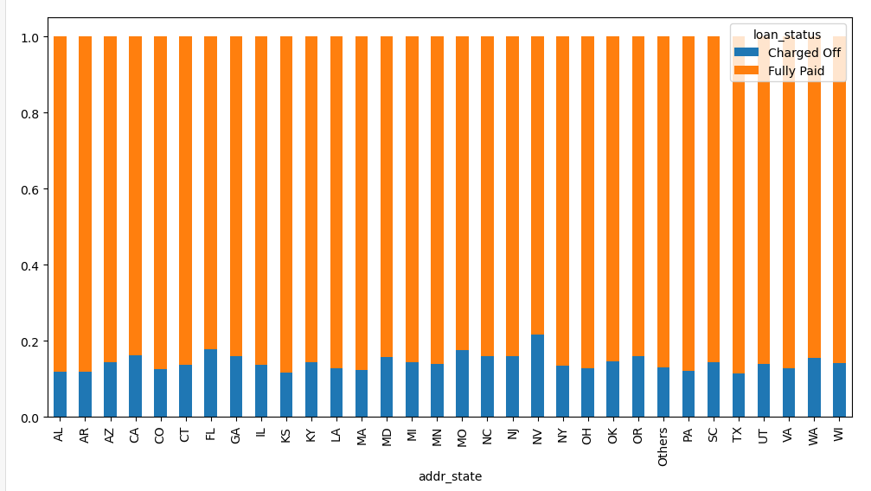
Bi-Variate Analysis
Loan status Vs addr state
Insights: For CA and NV proportion of charged off is more when compared to rest all

Slide 30
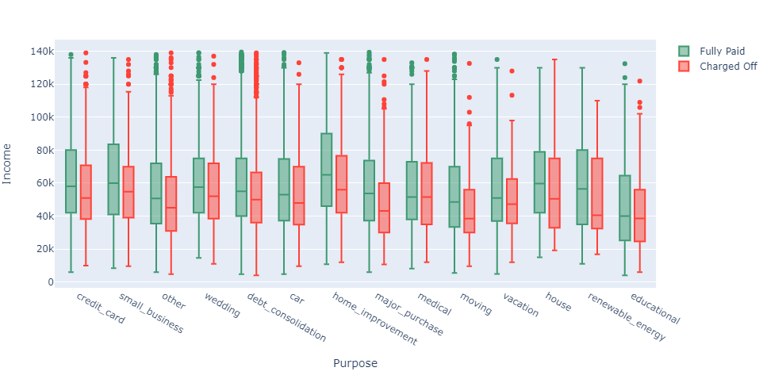
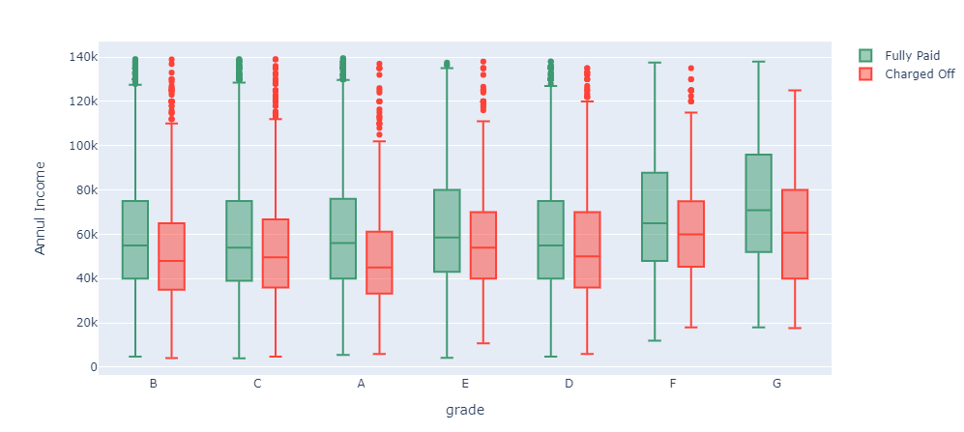
Multi Variate Analysis
Grade G and Annual Income < 52K chance of default is high
Purpose is home improvement/major purchase & income is lower than 80k/60k then higher chance of charged off

Slide 31
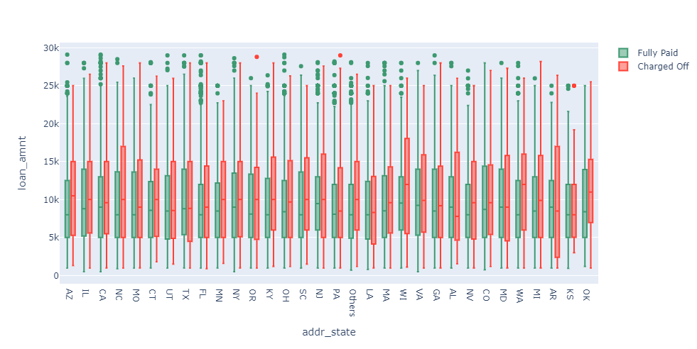
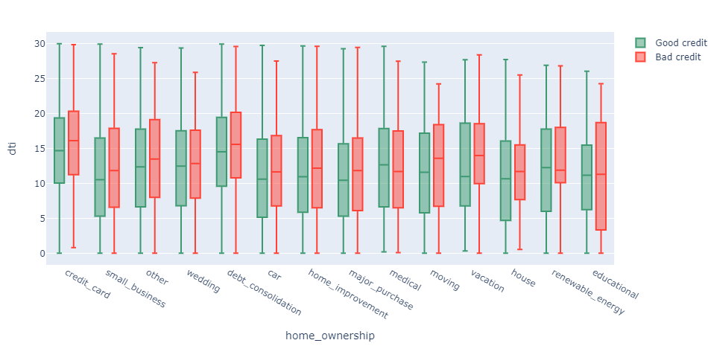
Multi Variate Analysis
States WA, TX, NJ, VA higher loan amount has a higher chance of charged off
All purposes higher dti means higher chance of charged off, but educational, lower dti also leads to chargeoff (not valid)

Slide 32
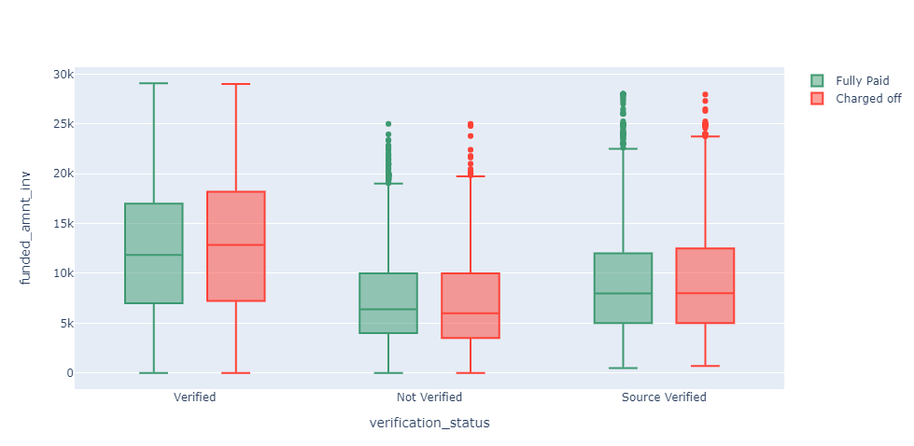
Multi Variate Analysis
Funded Amount Inv is higher if source is verified for all loan status (charged off and fully paid)

Slide 33
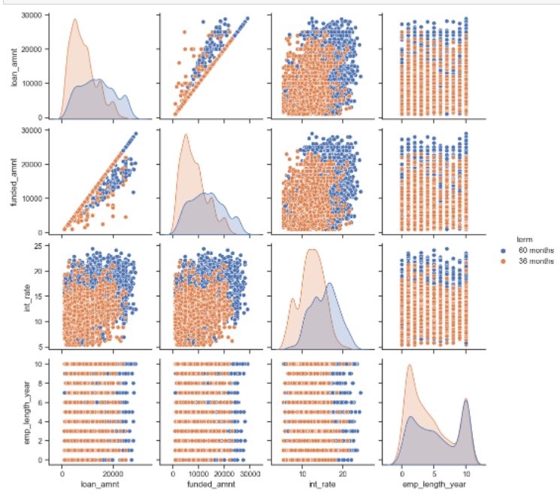
Multi-Variate Analysis (Pair Plot)
1.Loan amount and funded amount is positively correlated
2.lower interest rate <=18 & funded amount <=20000 were using term 36 months.
3. Higher interest rate :>25 and funded amount upto 30000 were using loan tearm 60 months
4. Irrespective of emp_length , when funded amount > 20000 loan term used is 60 months
5. Irrespective of emp_length , when funded amount < 20000 term used is 36 months
6. if loan amount > 20000, more 60 months term is observed , loan amount < 20000 36 months term is used
7. if funded amount > 20000, more 60 months is observed , funded amount < 20000 36 months is applied
8. Across all emp length for lower int rate <=18 , 36 months is used. for int rate above 18 , 60 months is observed

Slide 34
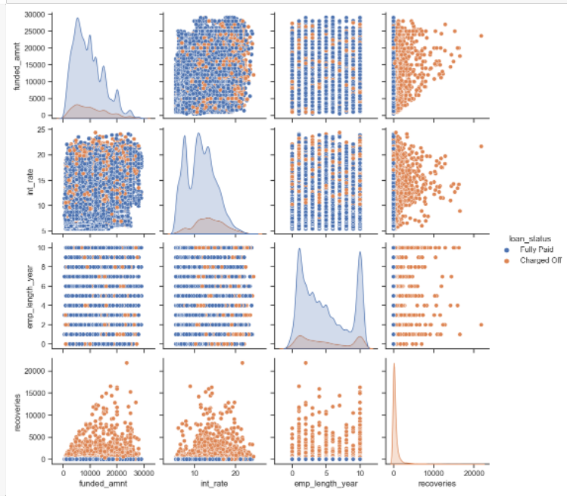
Multi-Variate Analysis (Pair Plot)
1. Across all emp length with lower int rate till 10 , more is fully paid, Across all emp length once when the int rate > 10 both fully paid and charged off is there
2. Between emp_length vs funded amount , no clean seperation is observed
3. Between int_rate vs funded amount no clean seperation observed between fully paid vs charged off
4. Between int_rate vs recovery , recoveries were zero for fully paid irrespective of int rate . recorveries were higher for charged off acorss all emp length (same applied for all recovery. Recoveries is closely associated to charged off . Not for fully paid)

Slide 35
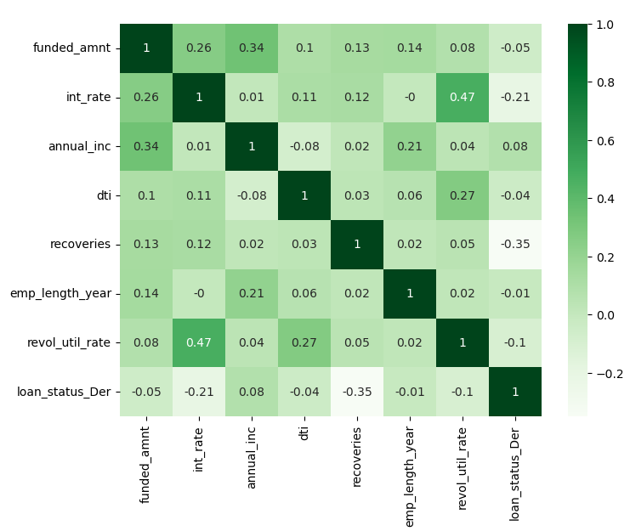
Multi-Variate Analysis
1. loan status towards fully paid is influenced by features like annual income , more higher the annual income more is fully paid
2. loan status towards charged off is influenced by features like
a, funded amount (Higher funded amount lower is fully paid(higher is charged off)
b. int_rate (Higher int rate lower is fully paid(higher is charged off),
c. dti (Higher dti lower is fully paid(higher is charged off),
d. pub rec bankruptcies, ((Higher pub rec bankruptcies lower is fully paid(higher is charged off)
e. emp length year, (Higher emp length year lower is fully paid(higher is charged off)
f. revol_util_rate, emp title (Higher revol util rate lower is fully paid(higher is charged off)
if emp title is absent more higher is charged off , et

Slide 36
Conclusion
Conclusion towards features driving loan defaulters:
1. loan_term : charge off increases with loan team 60 months
2. Annual Income: Income less than 60 k higher chances of charged off
3. Interest rate
4. Verification status
5. Home ownership
6. emp_length: Higher emp_length higher is charged off(observe charged off comapartive pattern)
7. grade and subgrade: As grade increases charged off increases , same applied ot sub grade
8. loan amount : Higher loan amount increases charge off
9 Emp title : when emp title is not mentioned more likely that they are not employed so annual income would be reduced and more charged off

Slide 37
Conclusion Contd
10 . Home ownership
11. dti :
12. Grade G and annual income < 52 k has higher chances of default
13 . Purpose is home improvement/major purchase & income is lower than 80k/60k
14. funded amount high for source verified
15. States WA, TX, NJ, VA higher loan amount has a higher chance of charged off
16.

